Slide 1
冒險故事
(VTube Studio)

Slide 2
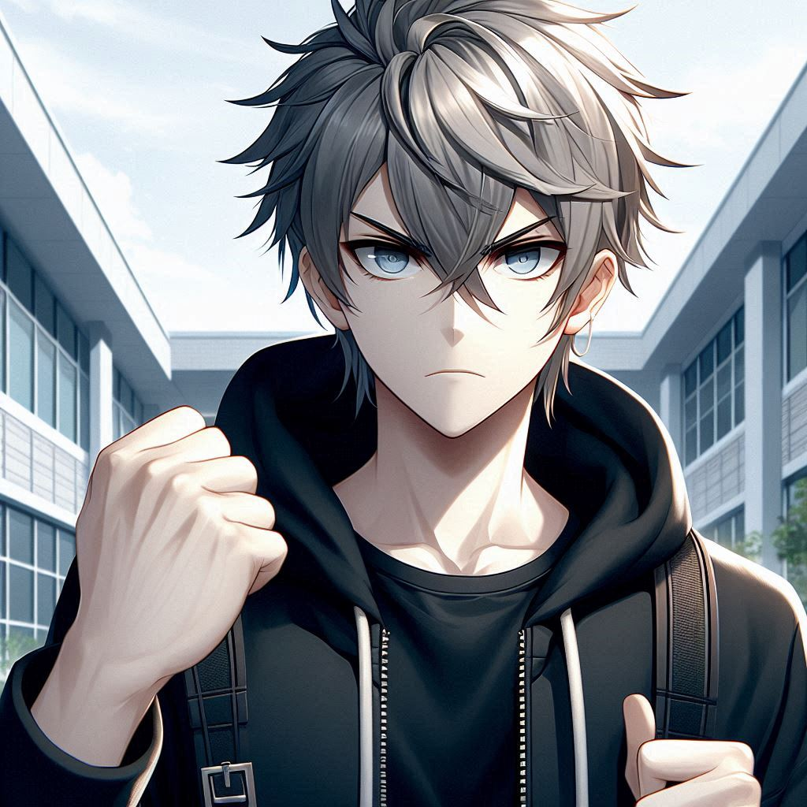
Notes:
Japanese anime style male high school student, tall and thin, fair complexion, with mid-length hair that doesn't go past his shoulders and spiky silver hair with no black shadows, silver eyebrows that don't show his ears, wearing an all-black hoodie with no zipper and blue eyes, in front of a gym, very aggressive looking, making a fist-clenching gesture to show that he'll definitely be able to do it.
我第一次參加羽毛球單打比賽時，心中充滿期待，希望能在場上證明自己。

Slide 3
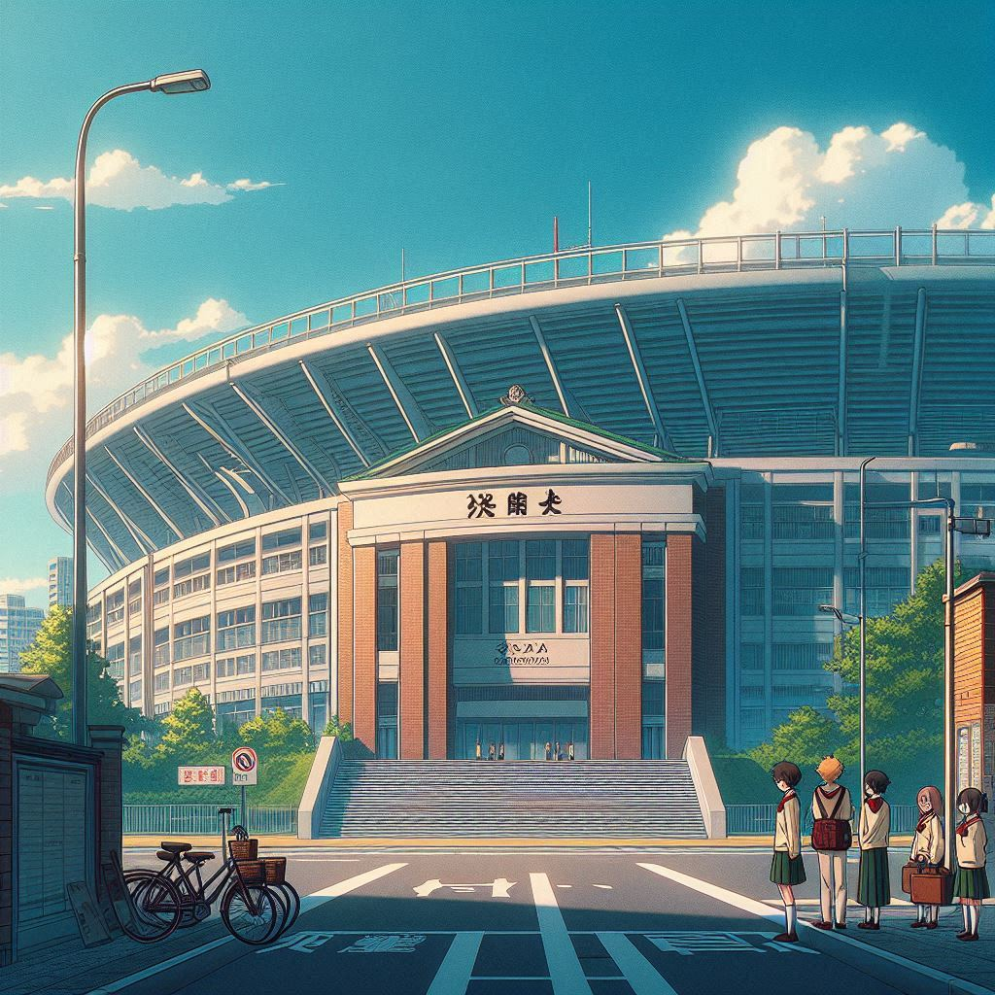
Notes:
Give me a scene outside a badminton stadium not including the characters, Japanese animation style
比賽那天，早早來到了比賽體育館，體育館看起來超大間的

Slide 4
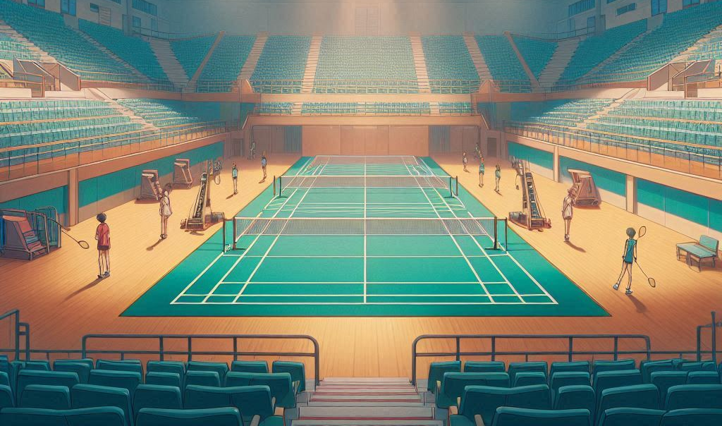
Notes:
Give me a scene inside a badminton stadium not including the characters, Japanese animation style
走到羽毛球場地，心中雀躍的心情壓抑不住

Slide 5
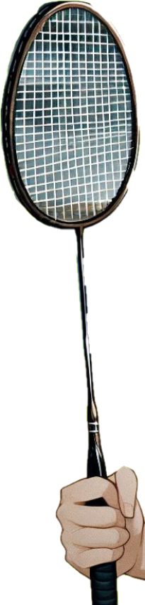

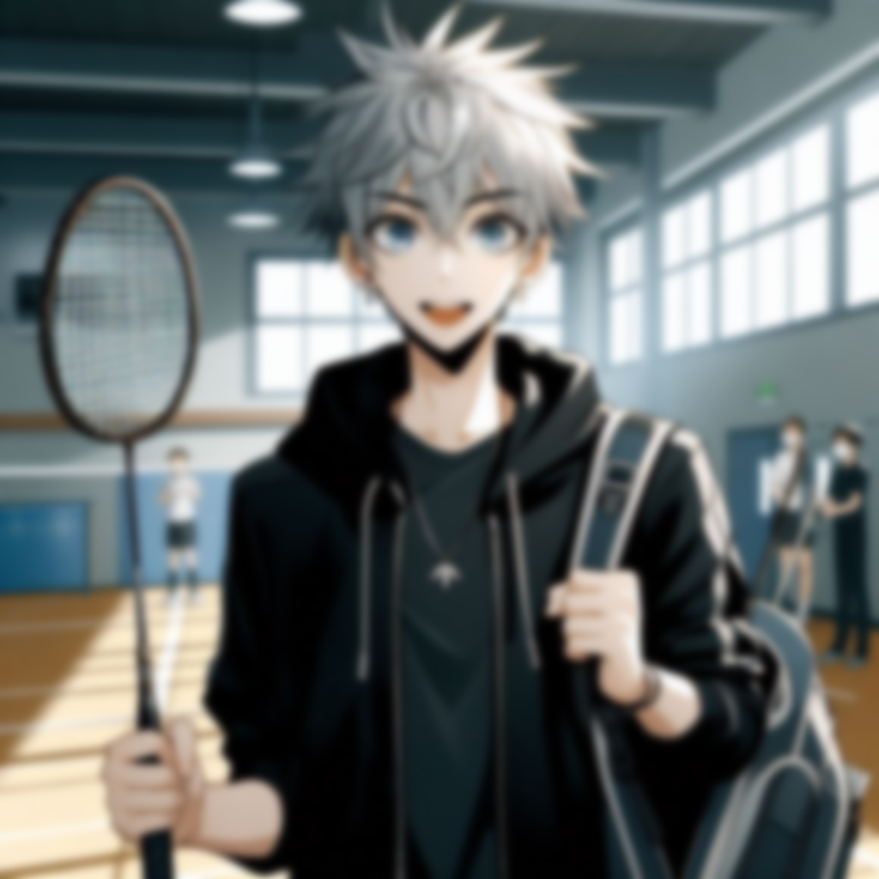
Notes:
The scene is inside a badminton gym with a Japanese anime-style male high school student, tall, thin, fair complexion, medium-length hair that doesn't go past his shoulders, spiky silver hair with no black shadows, silver eyebrows that don't peek out of his ears, wearing an all-black hoodie with no zippers, blue eyes, and carrying a badminton backpack with a shiny new badminton racket in his hand, feeling excited about it
我帶著新買的球拍和練習已久的戰術

Slide 6
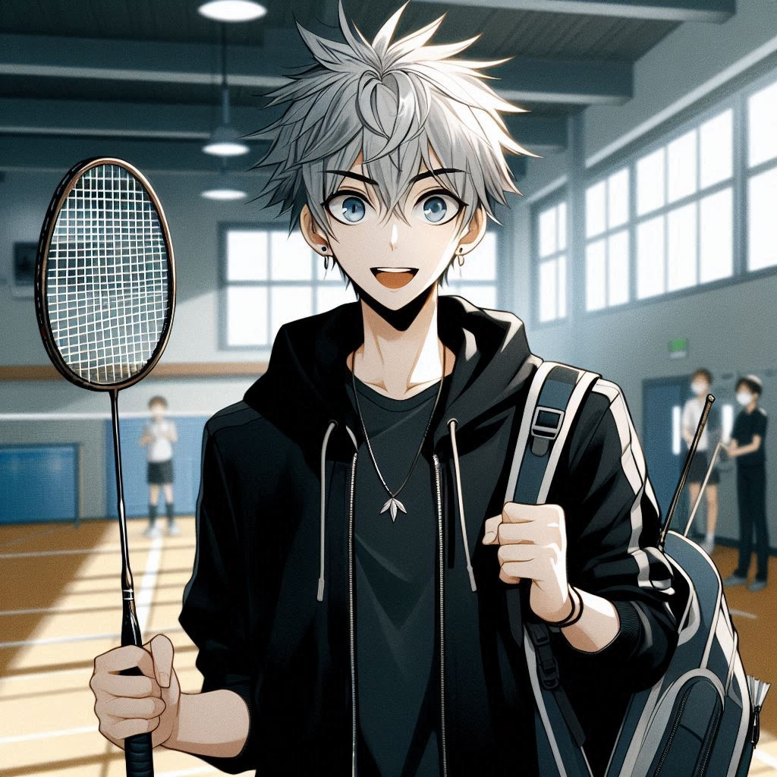
Notes:
The scene is inside a badminton gym with a Japanese anime-style male high school student, tall, thin, fair complexion, medium-length hair that doesn't go past his shoulders, spiky silver hair with no black shadows, silver eyebrows that don't peek out of his ears, wearing an all-black hoodie with no zippers, blue eyes, and carrying a badminton backpack with a shiny new badminton racket in his hand, feeling excited about it
我帶著新買的球拍和練習已久的戰術，覺得一定沒問題，不會輸

Slide 7
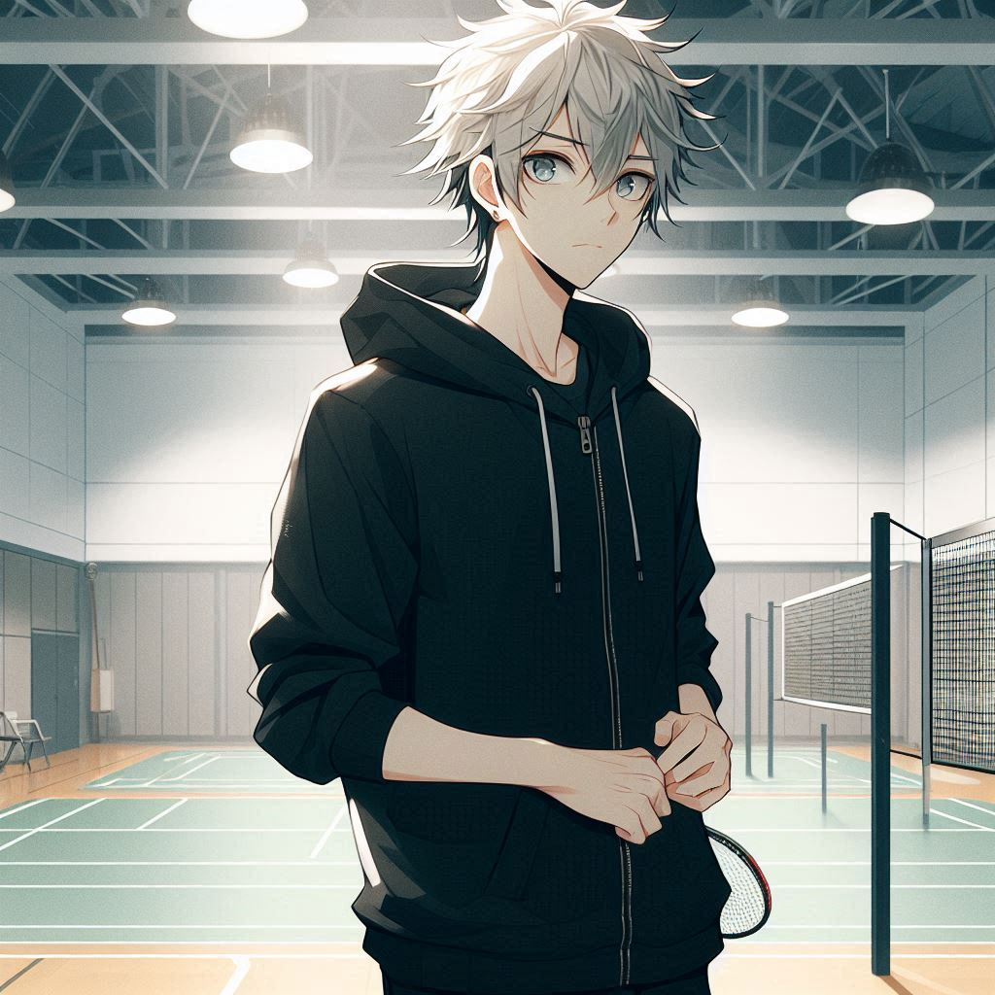
Notes:
The scene is on a badminton court, a Japanese anime style male high school student, tall and thin with a fair complexion, medium length hair that doesn't reach past his shoulders, silver spiked hair with no black shading, silver eyebrows that don't peek out of his ears, wearing an all black hoodie without a zipper, with blue eyes, looking around to see what everyone else looks like, with a slightly nervous look on his face
比賽時間快到了，選手紛紛的進場，當我四處看看周圍的的選手時，

Slide 8
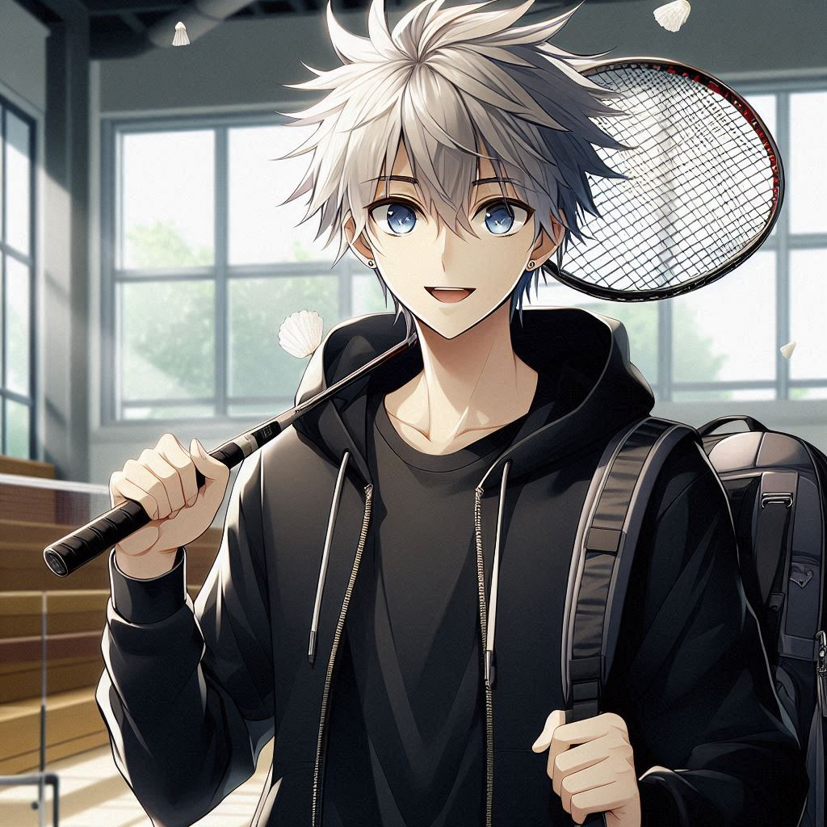
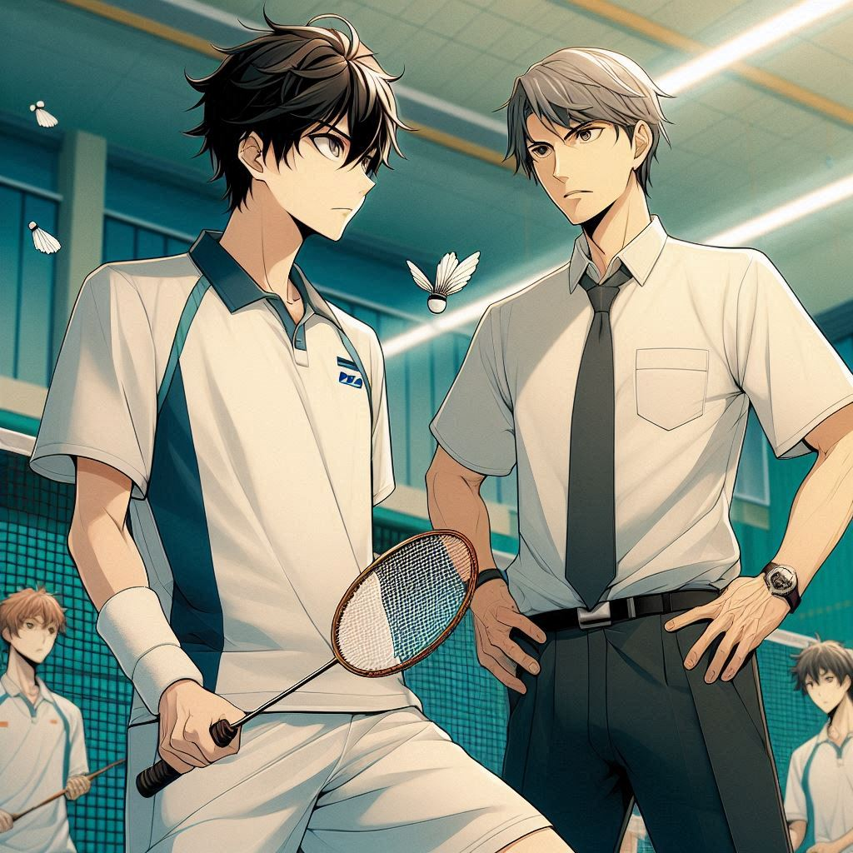
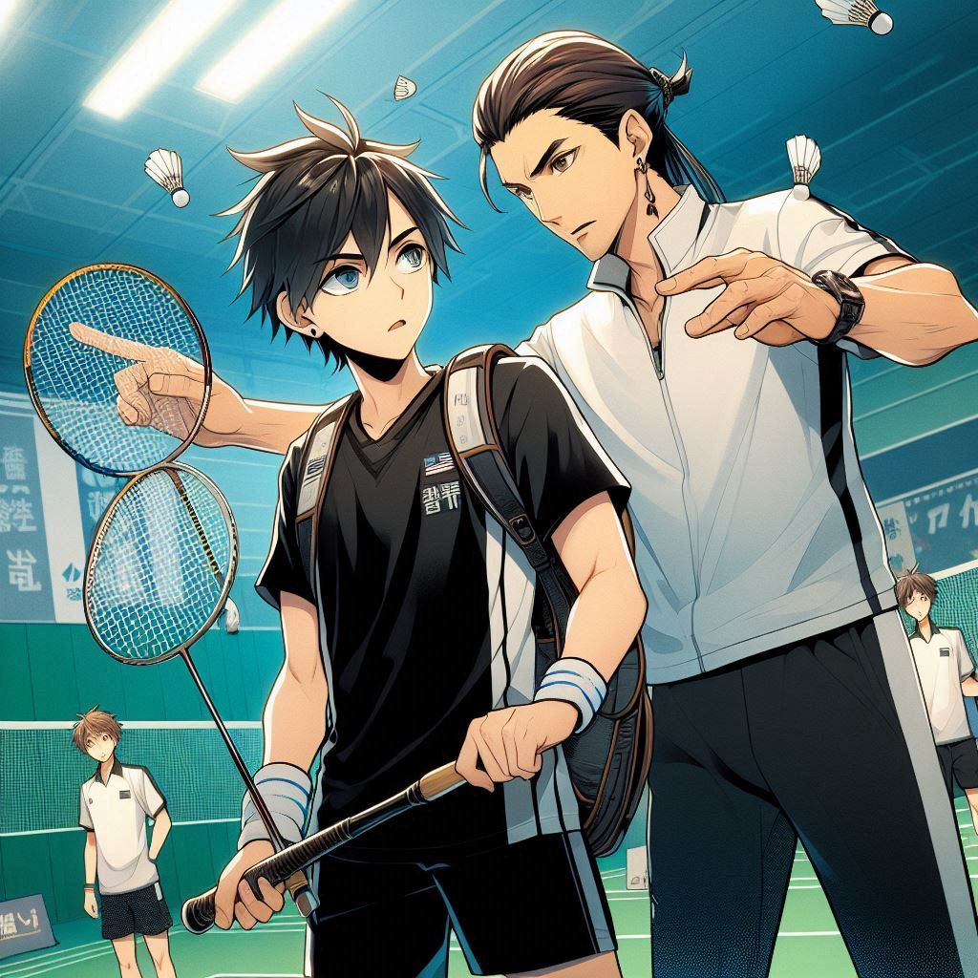
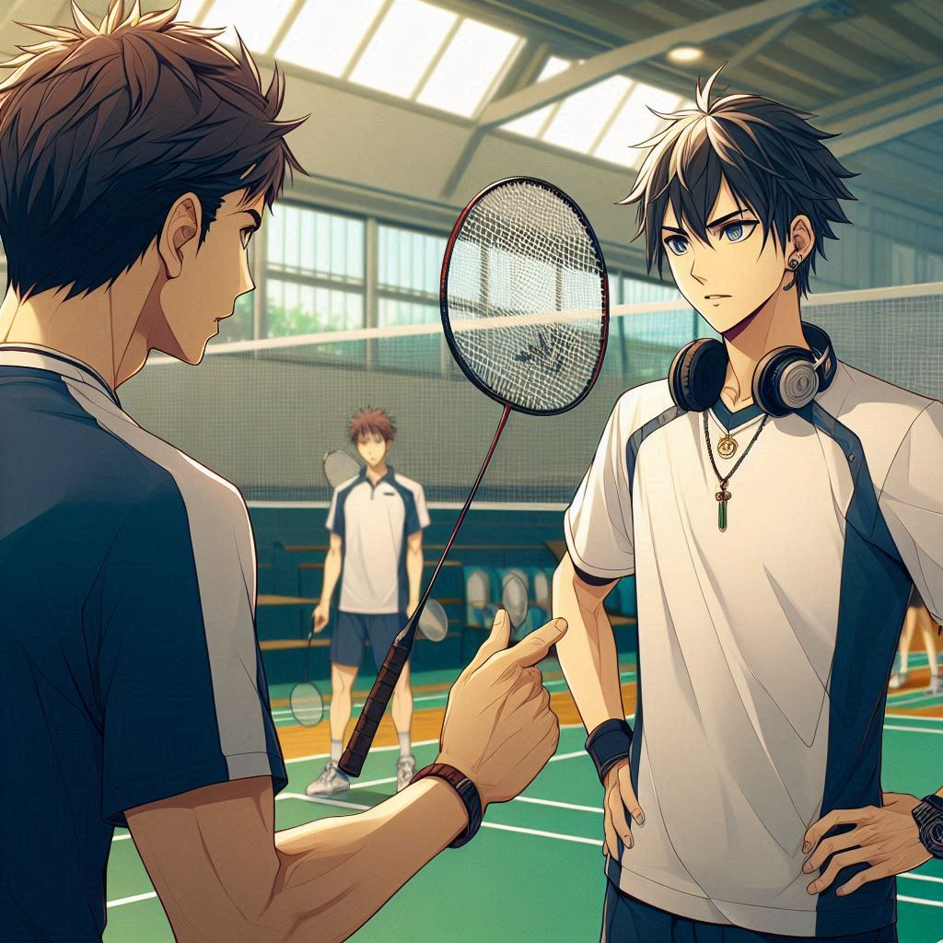
Notes:
Build a Japanese anime style scene.In a badminton scene, there are many badminton players wearing very professional equipment badminton rackets.Take a close-up of one of the badminton players and his coach instructing him.
發現其他參賽者看起來都十分有經驗，身穿專業運動裝備，還有教練在旁指導

Slide 9
Notes:
Build a Japanese anime style scene.In a badminton scene, there are many badminton players wearing very professional equipment badminton rackets.Take a close-up of one of the badminton players and his coach instructing him.
與我相比，感覺自己像個新手。

Slide 10
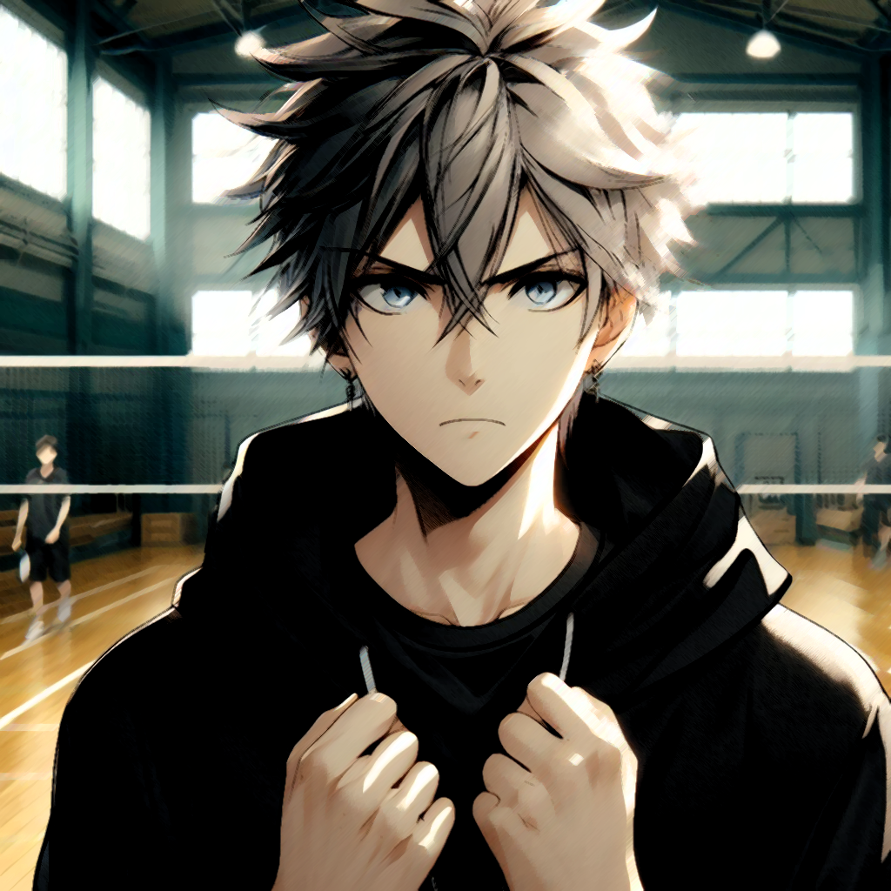
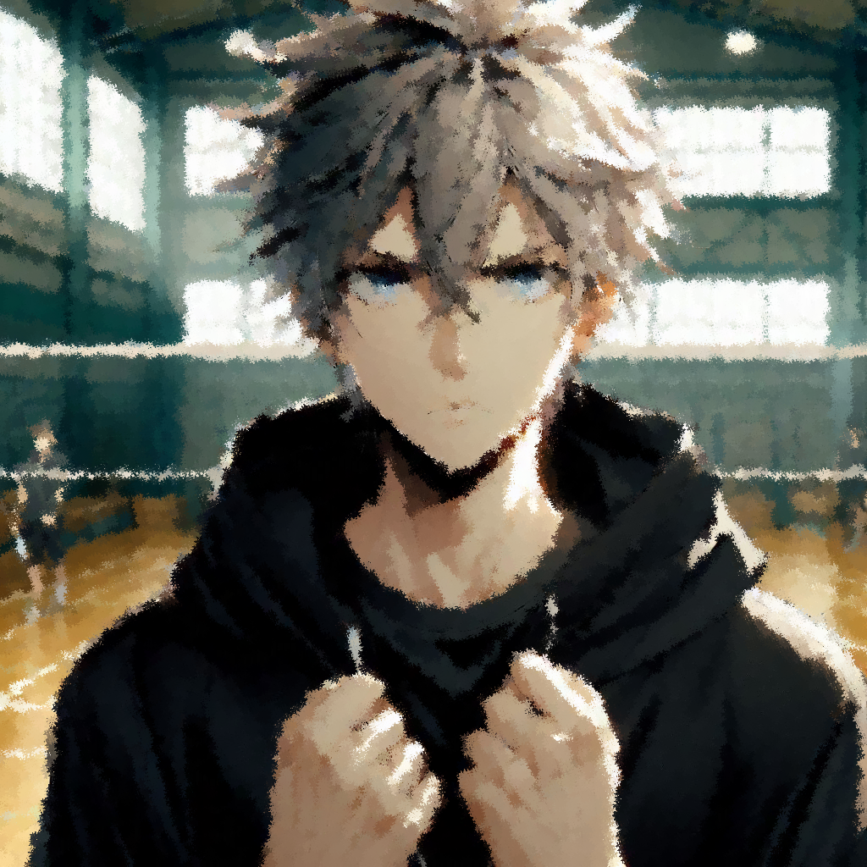
Notes:
The scene is a badminton court, a Japanese anime style male high school student, tall, thin, fair complexion, medium length hair that doesn't reach past his shoulders, silver spiked hair with no black shading, silver eyebrows that don't show out of his ears, wearing an all black hoodie with no zipper, blue eyes, and hands clenched in a tense and uneasy feeling.
雖然心裡有點慌，但我告訴自己，我來這裡是為了挑戰自己，而不是跟別人比較。

Slide 11

Notes:
The scene is a badminton court, a Japanese anime style male high school student, tall, thin, fair complexion, medium length hair that doesn't reach past his shoulders, silver spiked hair with no black shading, silver eyebrows that don't show out of his ears, wearing an all black hoodie with no zipper, blue eyes, and hands clenched in a tense and uneasy feeling.
我來這裡是為了挑戰自己，而不是跟別人比較。

Slide 12
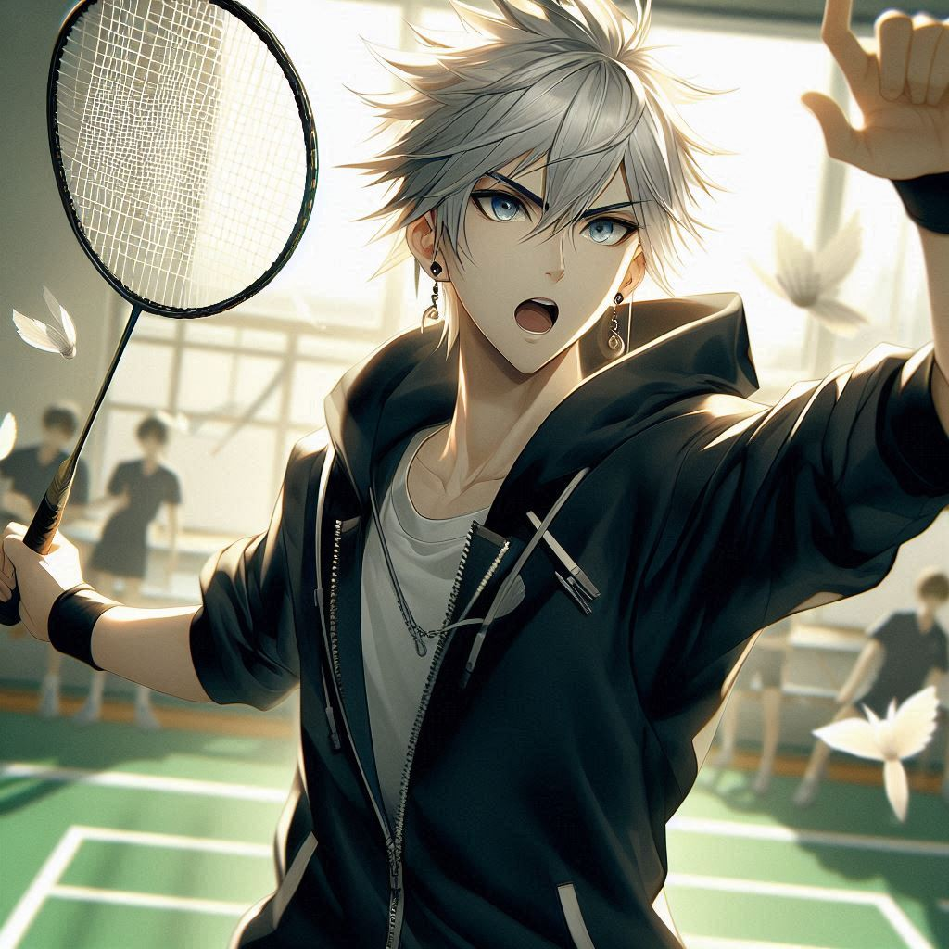
Notes:
The scene is a badminton court, and a Japanese anime-style male high school student, tall, thin, fair complexion, medium length hair that doesn't reach past his shoulders, silver spiked hair with no black shading, silver eyebrows that don't show his ears, wearing an all-black hoodie with no zipper, blue eyes, and a badminton racket in his hand, is impassioned and serious about playing badminton with a badminton player, close-up On me.
隨著比賽的哨聲響起，我迅速進入狀態

Slide 13
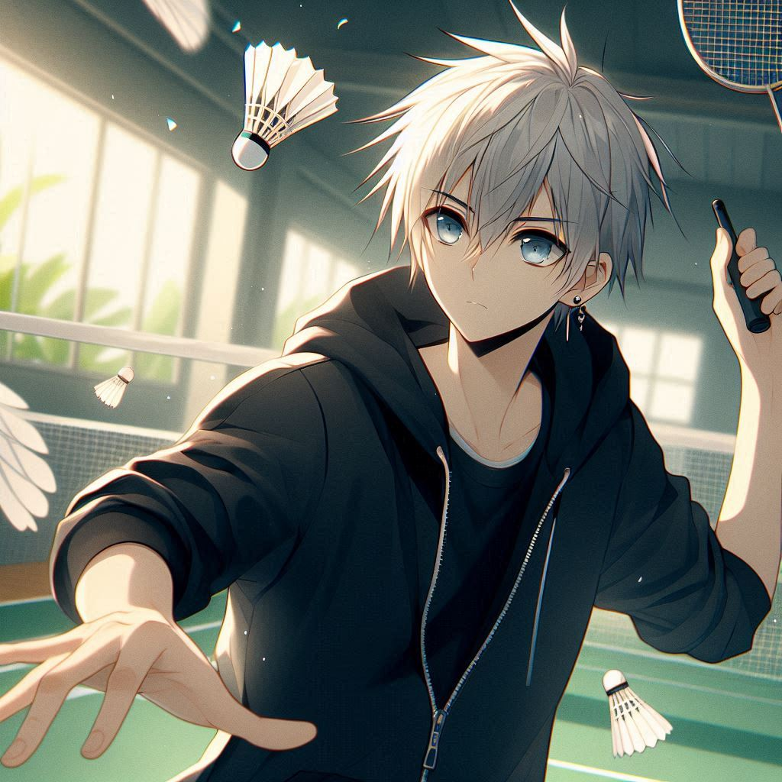
Notes:
The scene is a badminton court, and a Japanese anime style male high school student, tall, thin, fair complexion, medium length hair that doesn't go past his shoulders, silver spiky hair with no black shadows, silver eyebrows that don't show his ears, wearing an all black hoodie with no zipper, blue eyes, badminton racket in hand, is enthusiastically and seriously playing a badminton match with a badminton player, and in the close up view I am hitting it right to the center point of the badminton ball.
開始專注於每一個發球和回擊

Slide 14
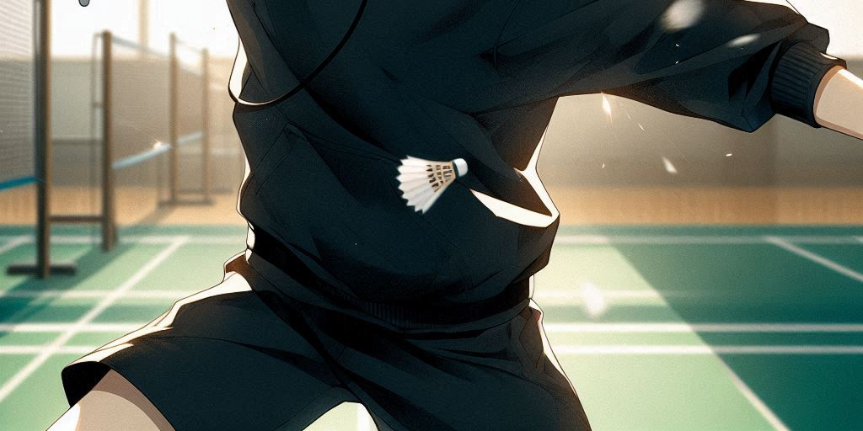
Notes:
The scene is a badminton court, and a Japanese anime style male high school student, tall, thin, fair complexion, medium length hair that doesn't go past his shoulders, silver spiky hair with no black shadows, silver eyebrows that don't show his ears, wearing an all black hoodie with no zipper, blue eyes, badminton racket in hand, is enthusiastically and seriously playing a badminton match with a badminton player, and in the close up view I am hitting it right to the center point of the badminton ball.
起初，一切都很順利，

Slide 15
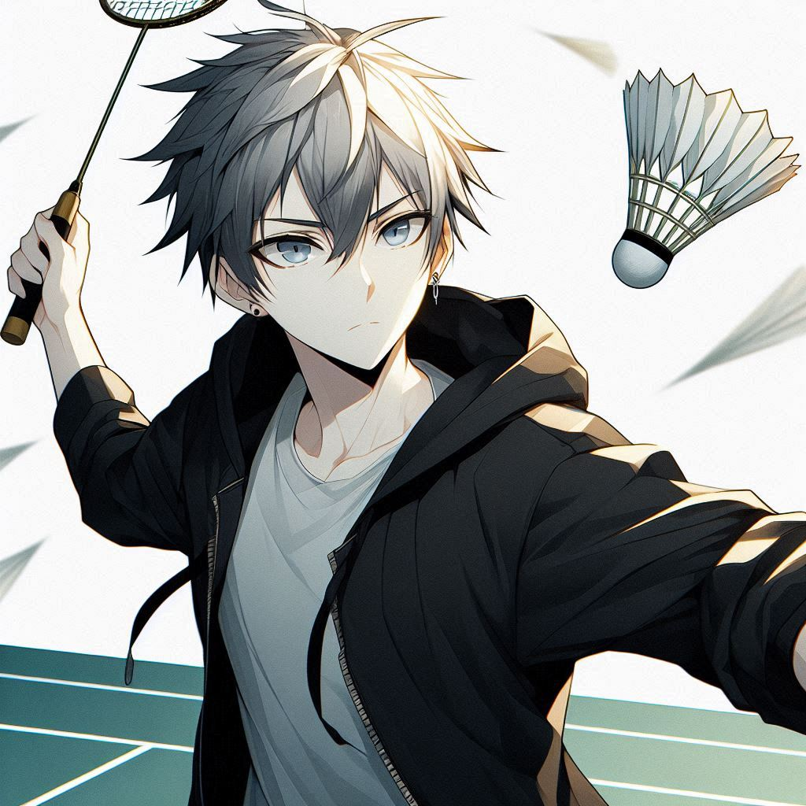
Notes:
The scene is a badminton court, and a Japanese anime style male high school student, tall, thin, fair complexion, medium length hair that doesn't go past his shoulders, silver spiky hair with no black shadows, silver eyebrows that don't show his ears, wearing an all black hoodie with no zipper, blue eyes, badminton racket in hand, is enthusiastically and seriously playing a badminton match with a badminton player, and in the close up view I am hitting it right to the center point of the badminton ball.
我的腳步靈活，擊球也很精準

Slide 16
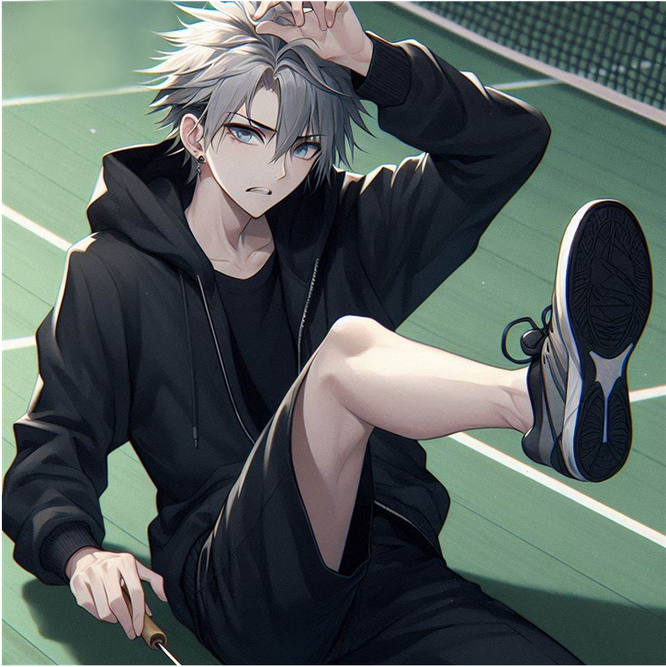
Notes:
The scene is a badminton court, a Japanese anime style male high school student, tall and thin, fair skinned, with mid-length hair that doesn't go past his shoulders, silver spikes with no shades of black, silver eyebrows that don't peek out of his ears, wearing an all-black hoodie without a zipper, with blue eyes and a badminton racket in his hand, for the moment of catching the ball, he suddenly twisted his foot and felt pain!
但就在比賽進行到中段時，意外發生了——我不小心在一次衝刺中扭到了腳。

Slide 17
Notes:
The scene is a badminton court, a Japanese anime style male high school student, tall and thin, fair skinned, with mid-length hair that doesn't go past his shoulders, silver spikes with no shades of black, silver eyebrows that don't peek out of his ears, wearing an all-black hoodie without a zipper, with blue eyes and a badminton racket in his hand, for the moment of catching the ball, he suddenly twisted his foot and felt pain!
痛感讓我瞬間停下來，內心感到焦慮和挫敗。

Slide 18
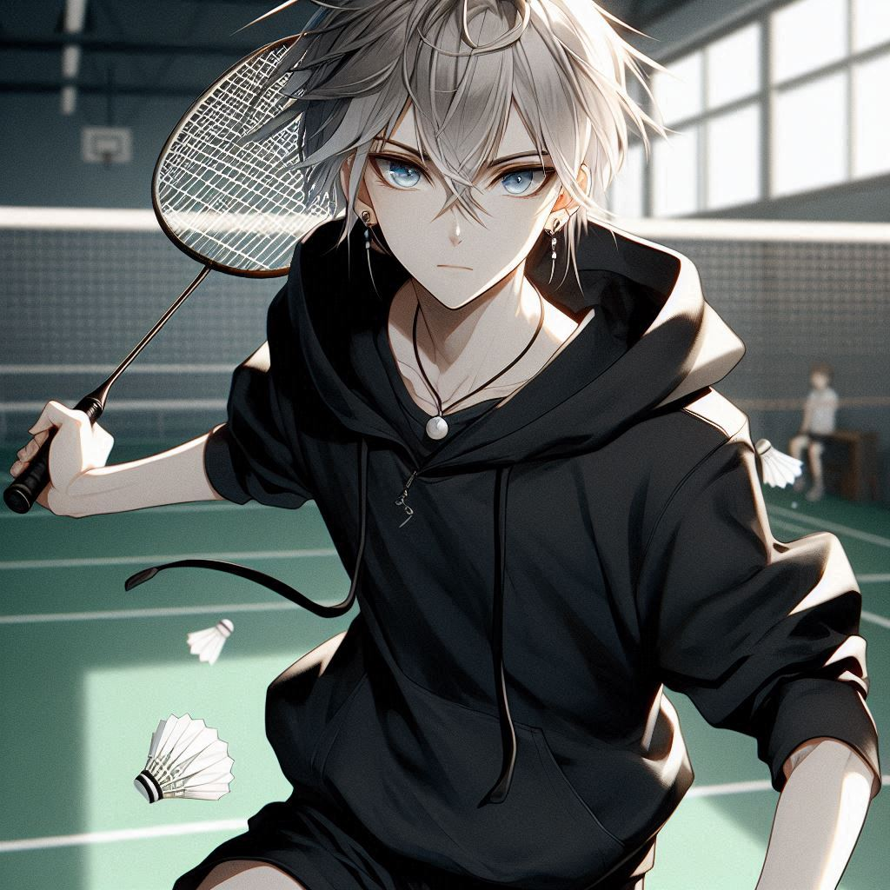
Notes:
The scene is a badminton court, a Japanese anime-style male high school student, tall, thin, fair-skinned, with mid-length hair that doesn't go past his shoulders, silver spikes that have no shades of black, silver eyebrows that don't peek out of his ears, an all-black hoodie with no zipper, blue eyes, a badminton racket in his hand, a strong-willed determination, and reddened knees
但我不想放棄，比賽還在繼續，我決定咬牙堅持，調整戰術，減少衝刺，更多利用控球和精準的打法。

Slide 19
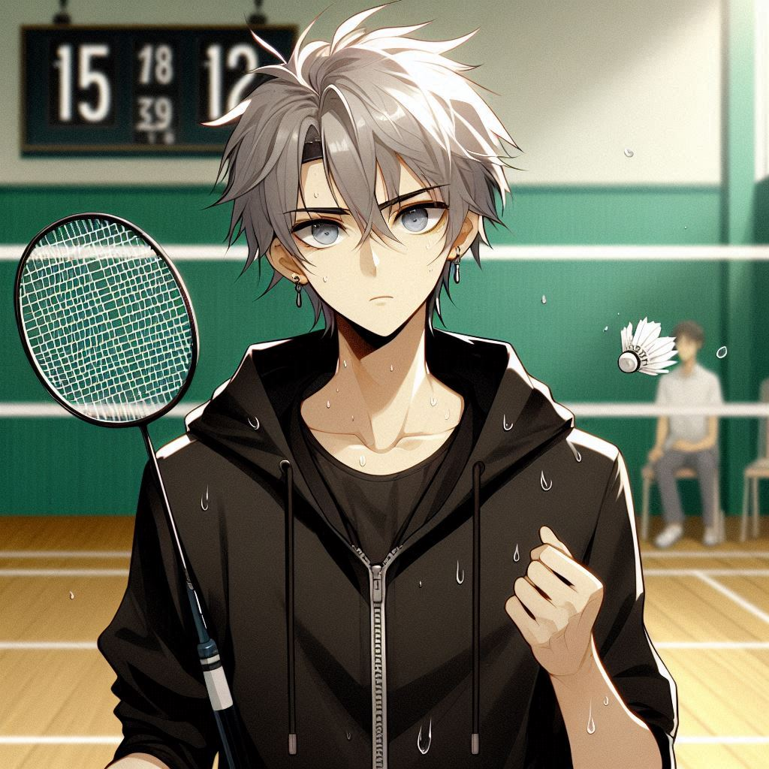
Notes:
The scene is a badminton court, a Japanese anime-style male high school student, tall, thin, fair-skinned, with medium-length hair that doesn't reach past his shoulders, silver spikes with no shades of black, silver eyebrows that don't peek out of his ears, wearing an all-black hoodie without a zipper, with blue eyes, a badminton racket in his hand, with sweaty samples and a sad face as he looks at the score on the phantom badminton scoreboard of the 15 to 12.
最終，還是打輸了，儘管沒能贏下這場比賽，我還是挺起胸膛，為自己的努力感到驕傲。

Slide 20
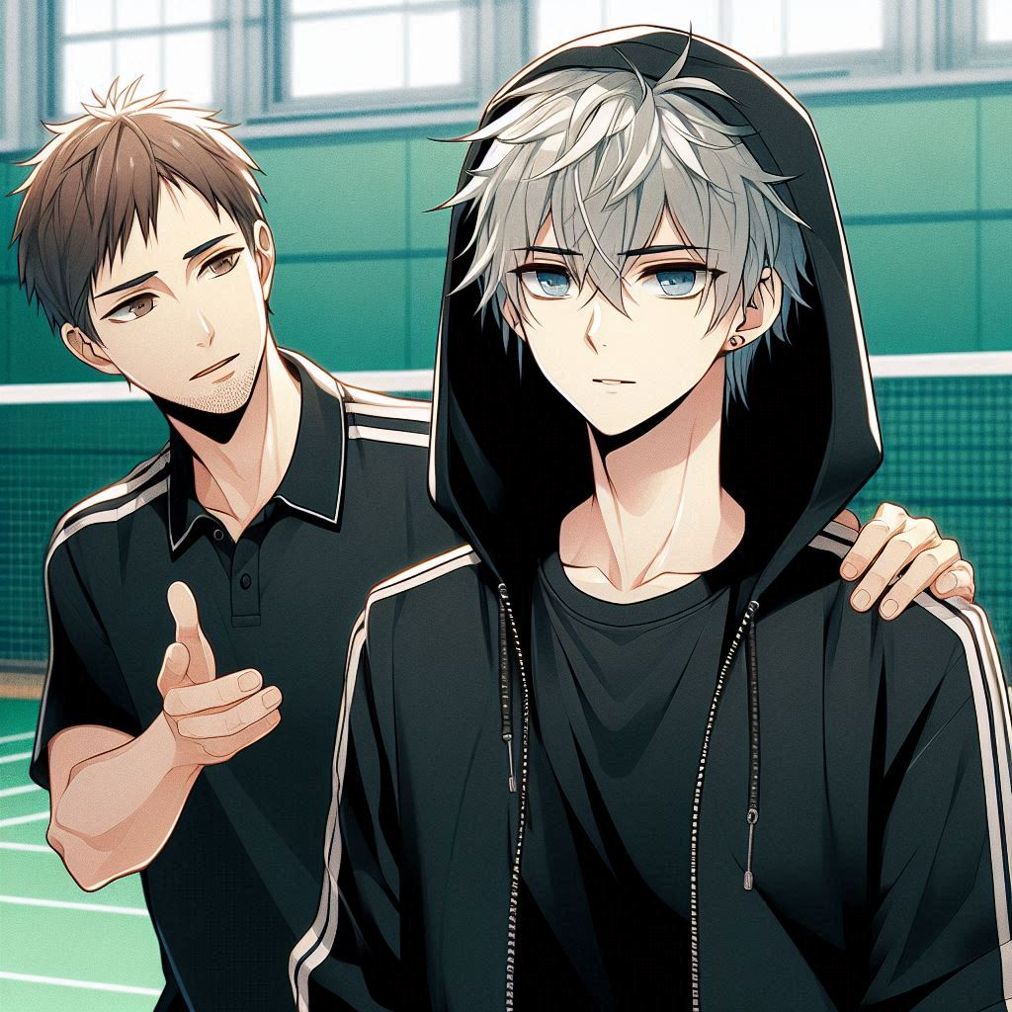
Notes:
The scene is a badminton court, a Japanese anime style male high school student, tall, thin, fair skinned, with medium length hair that doesn't go past his shoulders, silver spikes with no shades of black, silver eyebrows that don't poke out of his ears, wearing an all black hoodie with no zipper, with blue eyes, and a male trainer with short brown hair is talking to him and encouraging the boy with a hand on his shoulder.
當結果揭曉時，我雖然沒能晉級，但賽後，一位教練走過來，對我說他看到了我的潛力，並鼓勵我繼續努力。

Slide 21
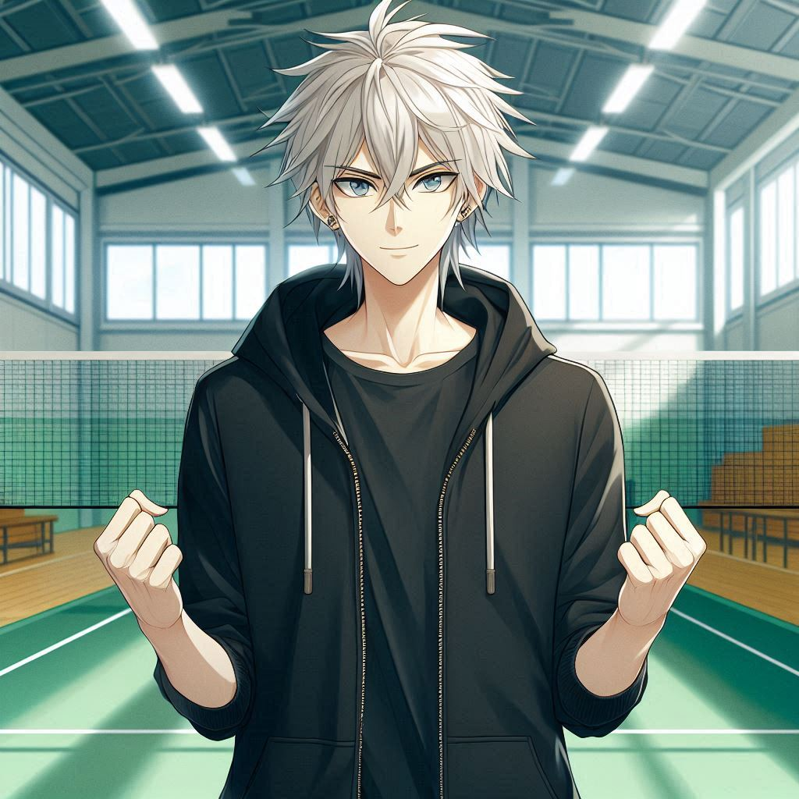
Notes:
The scene is a badminton court, a Japanese anime-style male high school student, tall, thin, fair-skinned, with medium-length hair that doesn't reach past his shoulders, silver spikes that have no shades of black, silver eyebrows that don't poke out of his ears, an all-black hoodie with no zipper, eyes that are blue, and an expression of confidence, his hands clenched in fists
這讓我意識到，比賽的結果並不是唯一的重點，這次經驗教會我如何在困難中堅持，並激發我對羽毛球的更大熱情。這只是我羽毛球之路的開始，我會繼續追求自己的夢想。

Slide 22
Notes:
The scene is inside a badminton gym with a Japanese anime-style male high school student, tall, thin, fair complexion, medium-length hair that doesn't go past his shoulders, spiky silver hair with no black shadows, silver eyebrows that don't peek out of his ears, wearing an all-black hoodie with no zippers, blue eyes, and carrying a badminton backpack with a shiny new badminton racket in his hand, feeling excited about it
這只是我羽毛球之路的開始，我會繼續追求自己的夢想。

